Slide 1
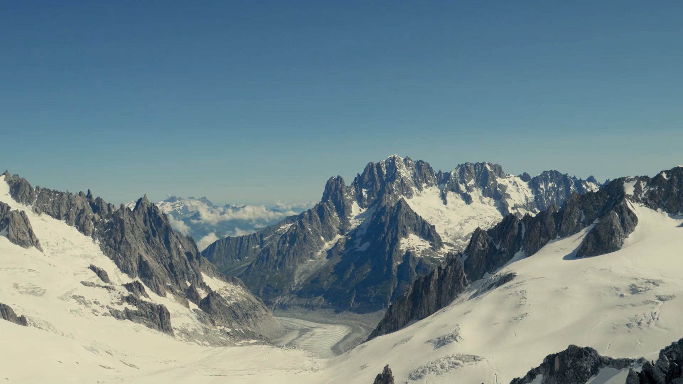
Big Mountain Presentation
By: Blake Hulett

Slide 2
Market Price of Tickets
To this point, Big Mountain has been using a simple average method to estimate the market price of tickets.
We have created a model that predicts ticket price based on available facilities.
Using this model, we have 3 sound recommendations for future action by Big Mountain’s executive team.

Slide 3
Recommendations
Increase ticket price to $95
Add a 150ft run without additional snow cover
Permanently close down the least used run

